Slide 1
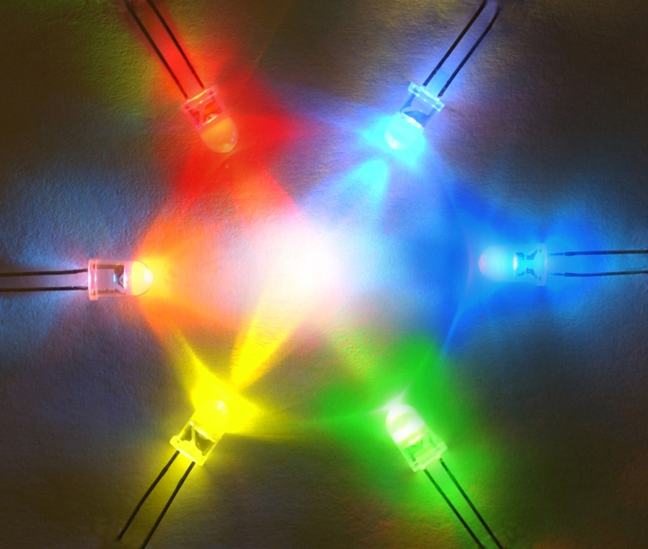
A Day in the Life of an Electrical or Computer Engineer
K. A. Connor
27 October 2010

Slide 2
Overview
Who Am I?
Why be an Engineer?
EE and CSE?
ECSE Alumni (with one ringer)
Demos
What are Alums Doing Today?
Demos
Questions

Slide 3
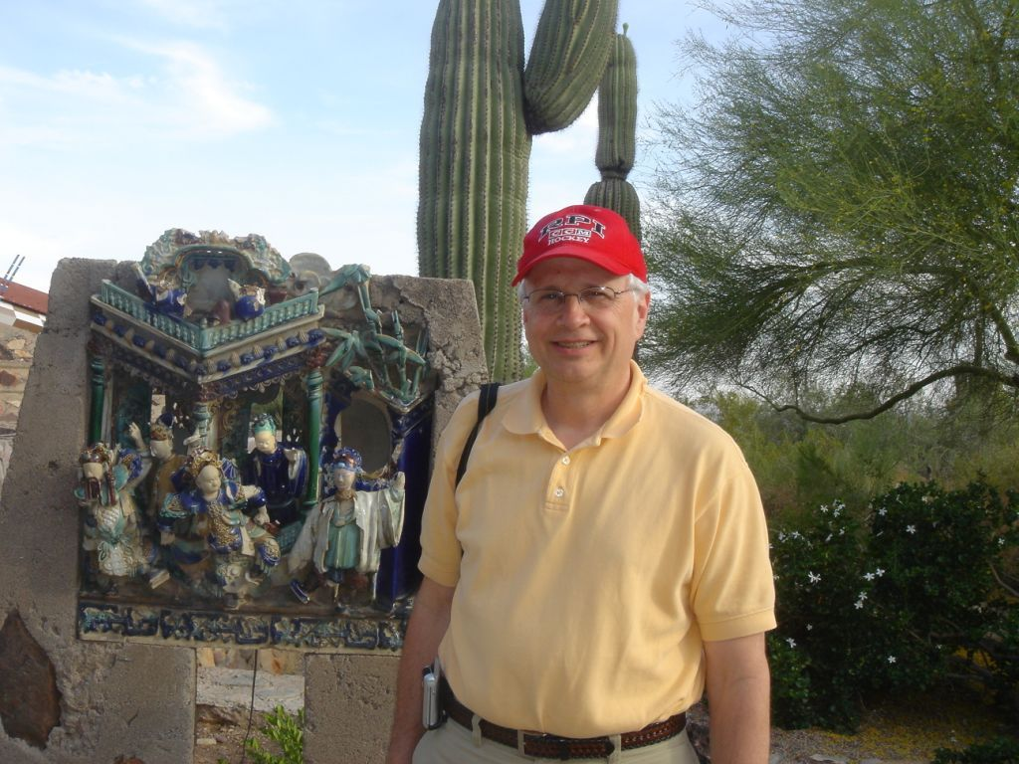
Who Am I?
I am a Professor of Electrical, Computer, and Systems Engineering and Information Technology and Education Director for the SMART LIGHTING Engineering Research Center
My name is Ken Connor

Slide 4
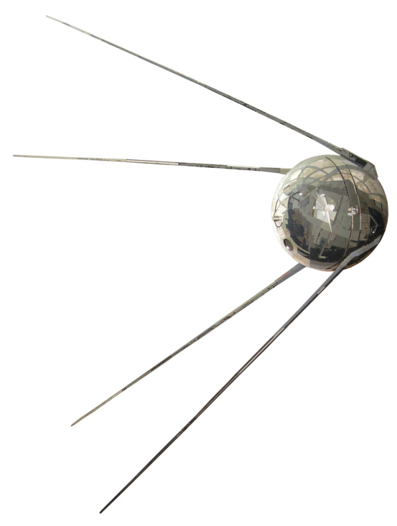
Why am I an Engineer?
October 1957 – Sputnik 1 (Спутник-1)
6th Grade Class – 4 students selected for advanced studies
7th & 8th Grade Math & Science Combined
Began HS Math & Science in 8th Grade
Diameter = 58.5 cm
Inside
Sounds
http://www.nytimes.com/interactive/2007/09/24/science/space/20070924_SPUTNIK_GRAPHIC.html#tab1
http://www.mentallandscape.com/Sputnik1_WashingtonDC.mp3

Slide 5
Me
29 March 1958

Slide 6
Why am I an Engineer?
Why did I go to engineering school when none of the other three accelerated students from my elementary school did?
My theory – my dad was the ‘go to’ person for our extended family … if anyone had a problem they could not solve, they asked him to help. This made his sons problem solvers … it does not matter what the problem was, we do our best to find a solution.

Slide 7
Why be an Engineer?
Engineers make a world of difference
Engineers are creative problem-solvers
Engineers help shape the future
Engineering is essential to our health, happiness and safety
From the NAE

Slide 8
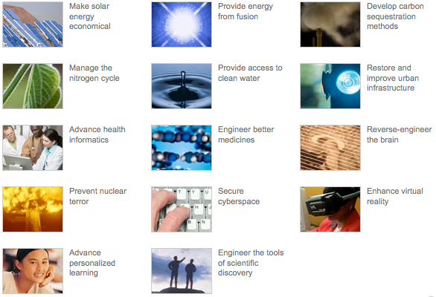
Also From NAE
My Research Area
Clearly ECSE Areas
Also ECSE Areas
Essentially all problems can be addressed from an EE or CSE platform

Slide 9
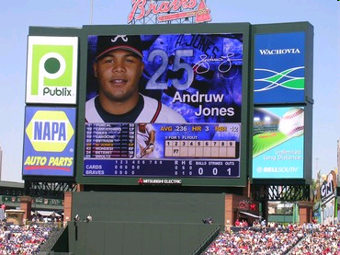
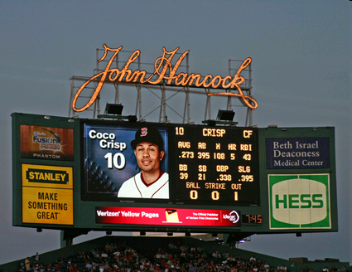
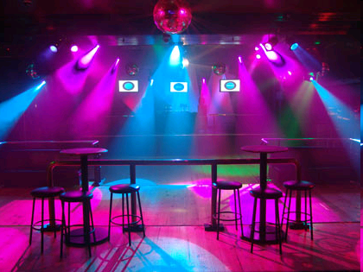
SMART LIGHTING
Smart Lighting System

Slide 10
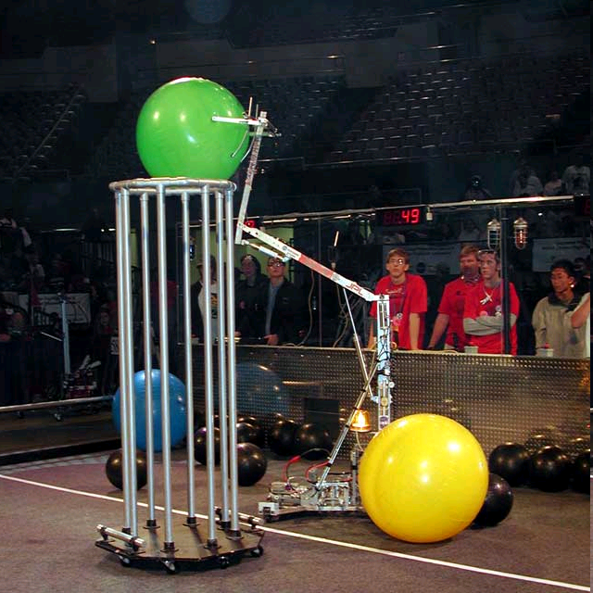
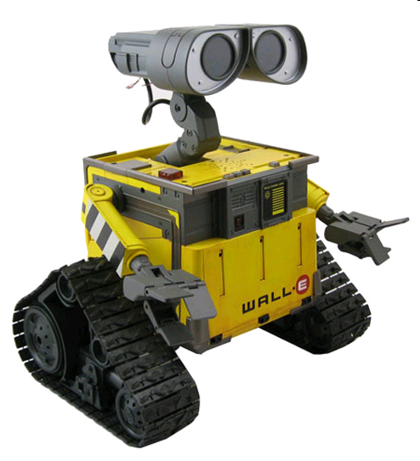
Similar to Robotics

Slide 11
EE and CSE Subdisciplines
Circuits and Electronics (Analog & Digital)
Signals and Systems
Controls
Communications
Electric Power
Radio Frequency Waves
Information (e.g. sound and images)

Slide 12
(Nearly 400k Members)
Aerospace and Electronic Systems Society
Antennas and Propagation Society (9,000 Members)
Broadcast Technology Society
Circuits and Systems Society (16,000 Members)
Communications Society (50,000 Members)
Components Packaging, and Manufacturing Technology Society
Computer Society (88,000 Members)
Consumer Electronics Society
Control Systems Society (10,000 Members)
Council on Super Conductivity
Dielectrics and Electrical Insulation Society
Education Society

Slide 13
Electromagnetic Compatibility Society
Electron Devices Society (13,000 Members)
Engineering Management Society
Engineering in Medicine and Biology Society
Geoscience & Remote Sensing Society
Industrial Electronics Society
Industry Applications Society
Information Theory Society
Intelligent Transportation Systems Council
Instrumentation and Measurement Society
Lasers & Electro-Optics Society (9,000 Members)
Magnetics Society
Microwave Theory and Techniques Society (12,000 Members)
Nuclear and Plasma Sciences Society
Neural Networks Council

Slide 14
Oceanic Engineering Society
Power Electronics Society
Power Engineering Society (22,000 Members)
Professional Communication Society
Reliability Society
Robotics & Automation Society
Sensors Council
Signal Processing Society (18,000 Members)
Society on Social Implications of Technology
Solid-State Circuits Society (14,000 Members)
Systems, Man, and Cybernetics Society
Ultrasonics, Ferroelectrics, and Frequency Control Society
Vehicular Technology Society

Slide 15
Electrical Engineering
Courses
Computer Science I & Computer Components and Operations
Multivariable Calc & Eng. Probability
Electric Circuits & Intro to Electronics
Signals and Systems & Electrical Energy Systems
Fields and Waves I & Microelectronics Tech.
http://www.ecse.rpi.edu/Templates/14_Templates_revised_8-10.pdf

Slide 16
Computer and Systems Engineering
Courses
Computer Science I, Data Structures, Intro to Algorithms,
Computer Components and Operations & Computer Architecture, Networks and Op. Sys.
Multivariable Calc, Discrete Structures & Eng. Probability
Electric Circuits, Intro to Electronics & Signals and Systems
http://www.ecse.rpi.edu/Templates/14_Templates_revised_8-10.pdf

Slide 17
Standard Dual Majors
EE & Applied Physics – 138 Credits
EE & CSE – 135 Credits
CSE & CS – 134 Credits
EE & BME – 135 Credits
Co-terminal degrees are also becoming more common.

Slide 18
Top 10 Starting Salaries 2010
Major | Average Salary Offer
Petroleum Engineering | $86,220
Chemical Engineering | $65,142
Mining & Minteral Engineering (incl. geological) | $64,552
Computer Science | $61,205
Computer Engineering | $60,879
Electrical/Electronics & Communications Engineering | $59,074
Mechanical Engineering | $58,392
Industrial/Manufacturing Engineering | $57,734
Aerospace/Aeronautical/Astronautical Engineering | $57,231
Information Sciences & Systems | $54,038
*Where 10 or more offers were reported.
Source: NACE

Slide 19
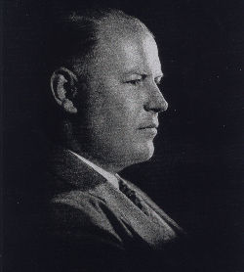
Allen Dumont
EE ‘24

Slide 20
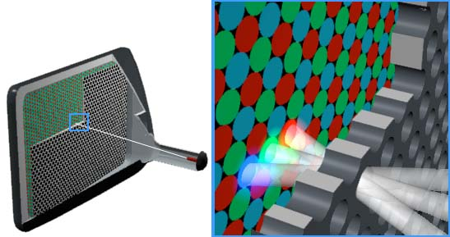
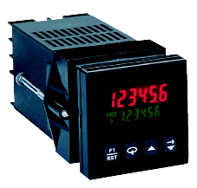
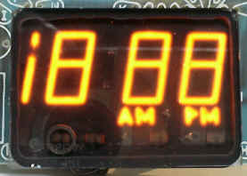
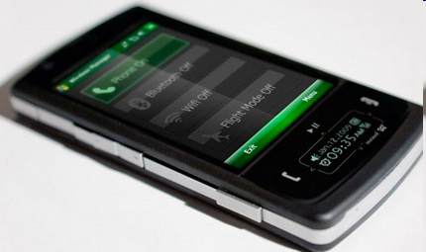
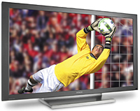
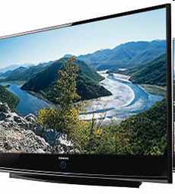
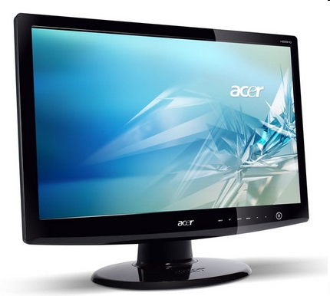
Displays
CRT
MirasolMEMS
Plasma
TI LED DLP MEMS
LCD

Slide 21
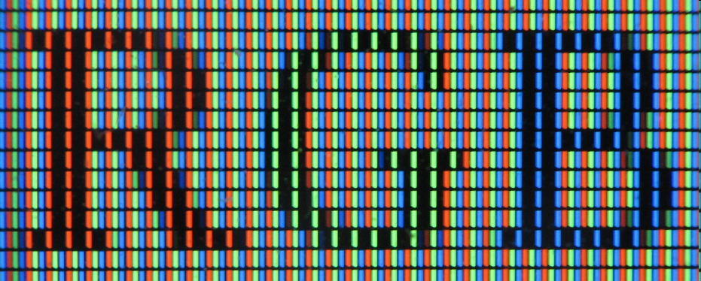
RGB

Slide 22
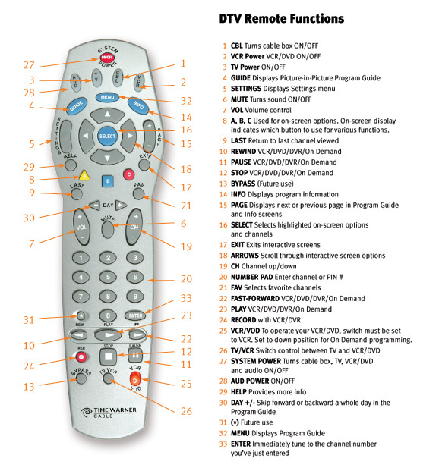
Remote Controls
Infrared Light
Cannot be seen by humans
Can be seen by digital camera
Remote control sends light flashes to TV or any other device it is to control
Example of Information Transfer System

Slide 23
Music Traveling on Light Flashes
We can hear the light flashes from the remote
Remote
Transmitter
Receiver
Speaker
Music Source
Sound

Slide 24
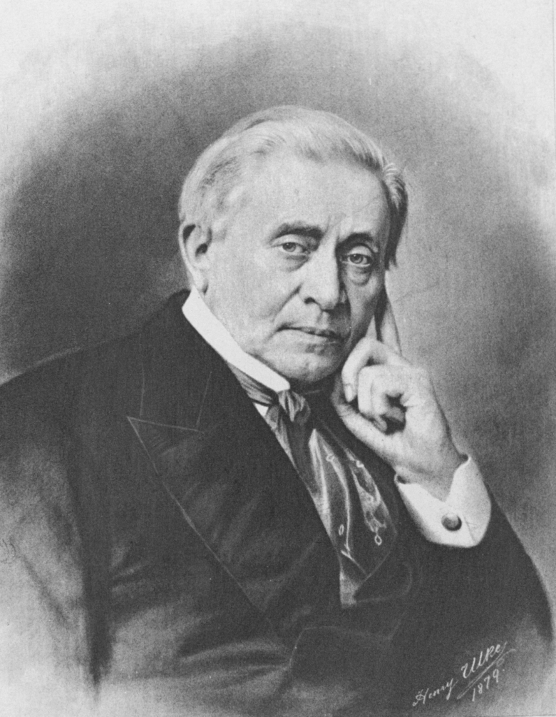
Joseph Henry
http://maps.google.com look up Albany, NY

Slide 25
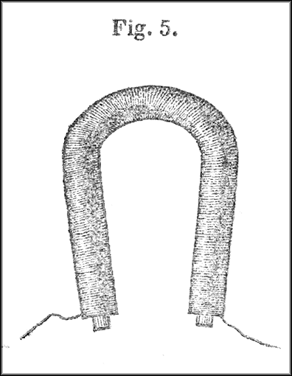
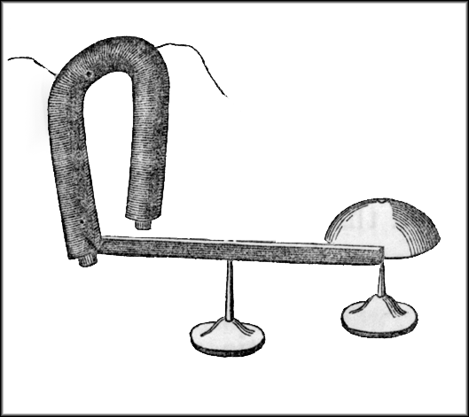
Joseph Henry
He recognized that the magnet could be the key part of a long distance signaling device – this became the telegraph

Slide 26
Coin Flipper
Launch Rockets Without Rocket Fuel?
Coin
Electromagnet

Slide 27
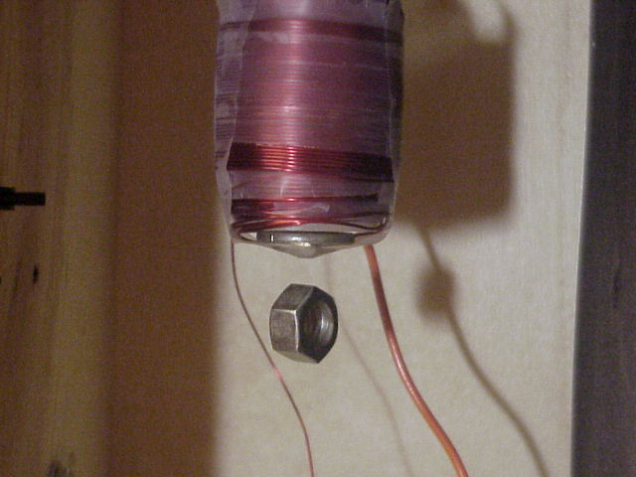
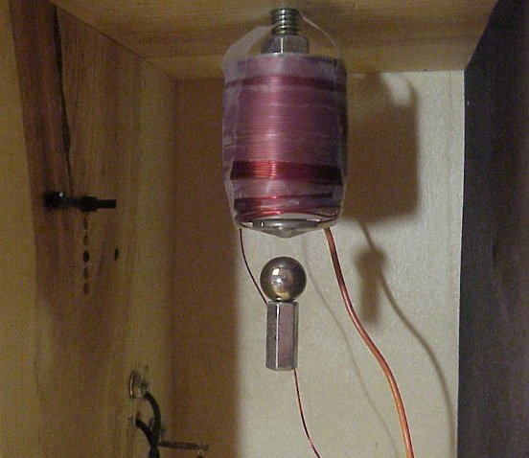
Maglev Experiment
Close up photos showing levitation of washer and ball bearing with magnet attached. Some preferred orientation is necessary for stability.
An invisible (IR) light beam ‘sees’ where the object is and tells the magnet how powerful it has to be to hold it in place.

Slide 28
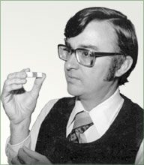
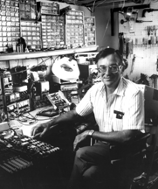
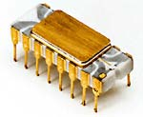
Marcian E. (Ted) Hoff
1937 Born in Rochester NY
1958 EE Degree from RPI
1962 PhD from Stanford
1971 Invented the Microprocessor (Intel 4004)

Slide 29
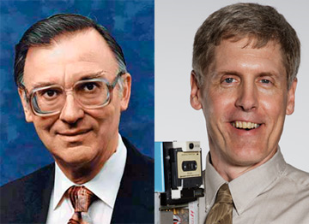
Two Rensselaer Alumni Receive National Medal of Technology and Innovation
Steven Sasson (Class of 1972) for the invention of the digital camera.
Dr. Marcian E. “Ted” Hoff, Jr. (Class of 1958), for the conception, design, development and application of the first microcomputer.
Dr. Marcian E. “Ted” Hoff, Jr. (Class of 1958), and Steven Sasson (Class of 1972)

Slide 30
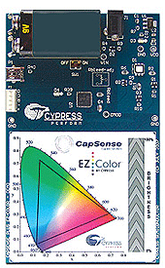
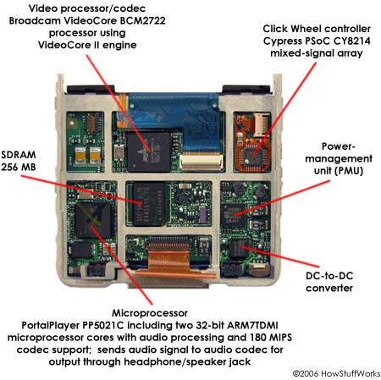
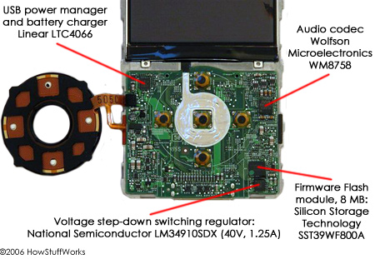
Ted Hoff Inspired
This is basically an EE, CSE project, with the emphasis on the latter.
What is this?

Slide 31
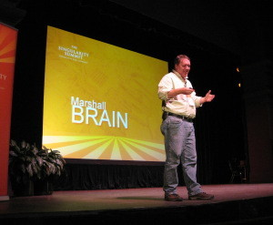
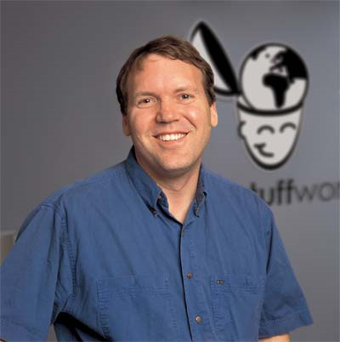
Marshall Brain
EE 1983

Slide 32
ECSE Graduates
Analog Devices
Lockheed Martin
ST-Ericsson
Nikon Precision
Time-Warner Engineering
Raytheon
Verizon
NXP
Toyota InfoTech Center
Applications Engineer
Software Engineer
Consulting Engineer
President
Director
Video Network Eng.
Product Engineer
Analyst
Sr. Principal
LinkedIn: search groups for ECSE

Slide 33
ECSE Graduates
BAE Systems
National Instruments
Bright View Tech
Intel
Mitsubishi Electric Research Lab
Current Group
Siemens Healthcare
Applied Materials
GE
Electrical Engineer
RF Systems Engineer
General Manager
Microprocessor Eng
Senior Principal Member Research Staff
CTO
VP R&D
Researcher
Project Manager
LinkedIn: search groups for ECSE

Slide 34
ECSE Graduates
Cadence
Altera
Arista Networks
Maxim-IC
uReach Technologies
ESPN
Microsoft
IBM
International Rectifier
Barclays
Cypress Semiconductor
General Manager
Sr Marketing Manager
Technical Staff
Managing Director & General Manager
Sr Product Manager
Process Engineer
Device Design Eng
Systems Integration and Testing Engineer
CEO
LinkedIn: search groups for ECSE

Slide 35
ECSE Graduates
Nordic Windpower
Marvell
Harris
Sikorsky Aircraft
Google
Seagate
Technicolor
Fairchild Semiconductor
Northrop Grumman
USAF
Product Manager
Sr Design Eng
Sr Scientist
Project Engineer
Network Engineer
Sr Engineering Director
Patent Attorney
Quality Engineer
Lead Systems Architect
Colonel
LinkedIn: search groups for ECSE

Slide 36
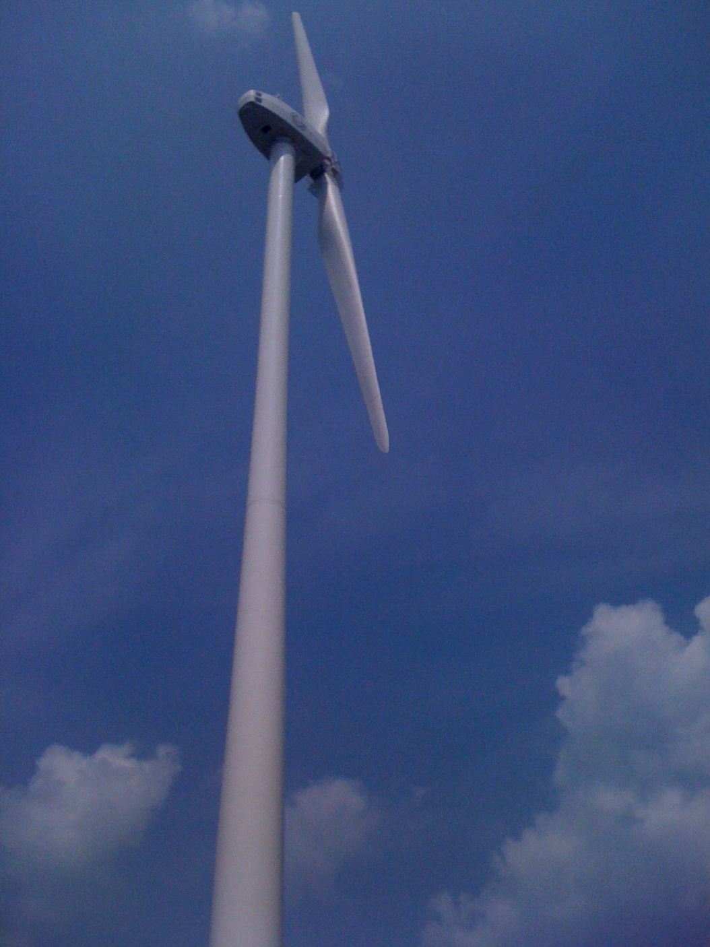
Our turbine is a 2 bladed, 1 MW machine. Most of the time I do product development work, but since our company is so small, and I have a lot of controls and system integration experience, I have had the opportunity to help out in the field a few times. Here is one of my most recent days doing some wind turbine commissioning in Indiana. We were having some issues with some of the sensors on top of the nacelle. We climbed the 70 m tower and got on top of the nacelle to make sure that all the instrumentation was in working order. Then we checked all the wiring in the cabinet in the nacelle and found that the issue was with noise on the RS485 comms network. I added a termination resistor at the and of the line and that took care of the problem. That may be more detail than you need... but I'm an engineer. I don't know how not to give too much information.

Slide 37
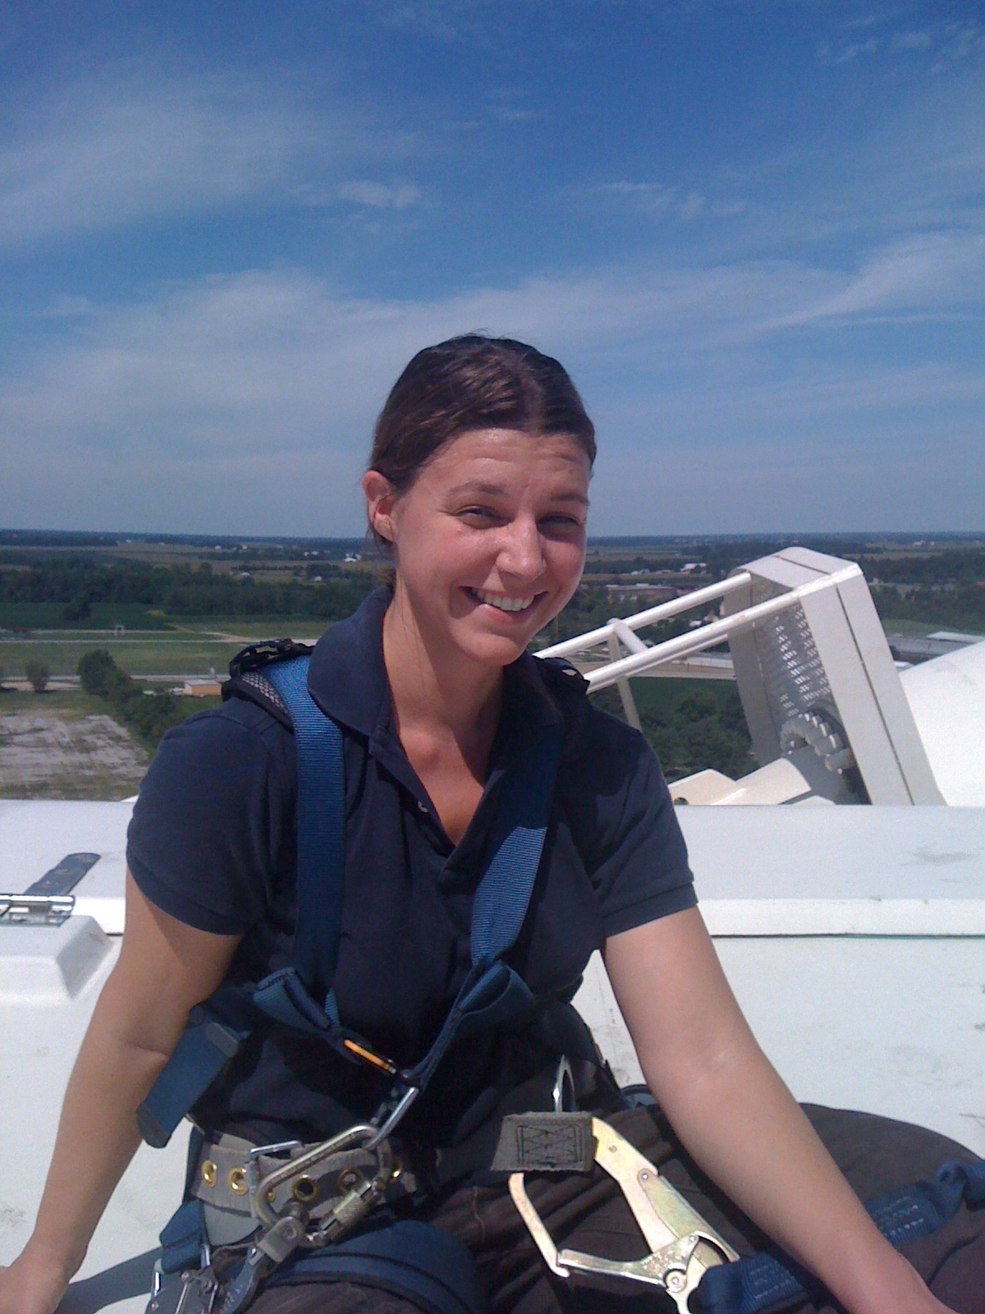
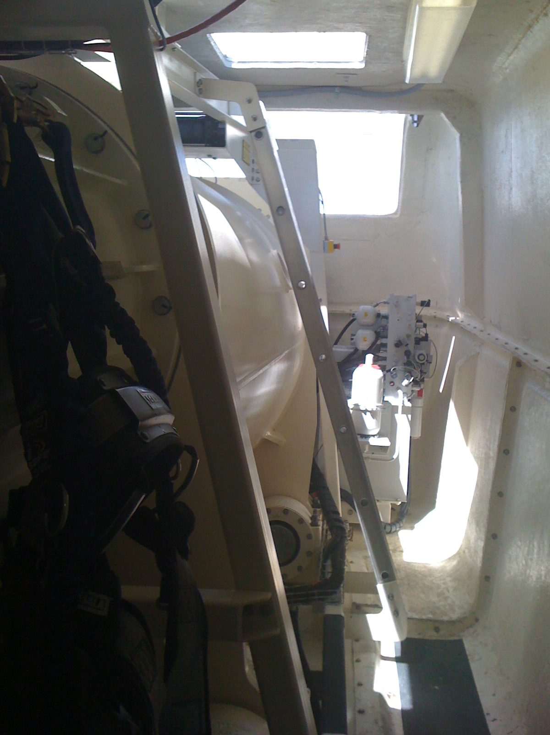
Carrie McLaughlin EE 2001

Slide 38
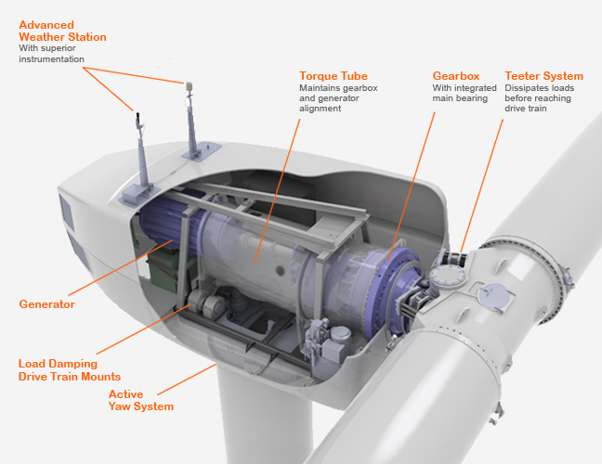

Slide 39
Dan Christman EE 1998
I started out in engineering as an applications engineer where the majority of my day would be spent in some combination of the following:
Evaluating new silicon in the lab (taking TOCs, measuring key parameters, testing it in application circuits, and generally trying to break it). Great practical experience.
Technical writing (data sheets for the new silicon, app notes and article for publication in magazines and the web). Gained a great detailed understanding of the parts.
Answering customer support questions over the phone or by email (I had to essentially be able to help a customer troubleshoot their circuit remotely on any of our over 2000 parts at the time. Really learned to be more intuitive about circuits.
After moving into marketing, my role changed significantly.
Many weeks of international travel meeting customers and defining specs and features for new products.
Business and operations tasks. Forecasting, pricing, advertising, production planning, etc.
Writing and presenting business plans to executive management. Revenue responsibility.
Many more meetings.

Slide 40
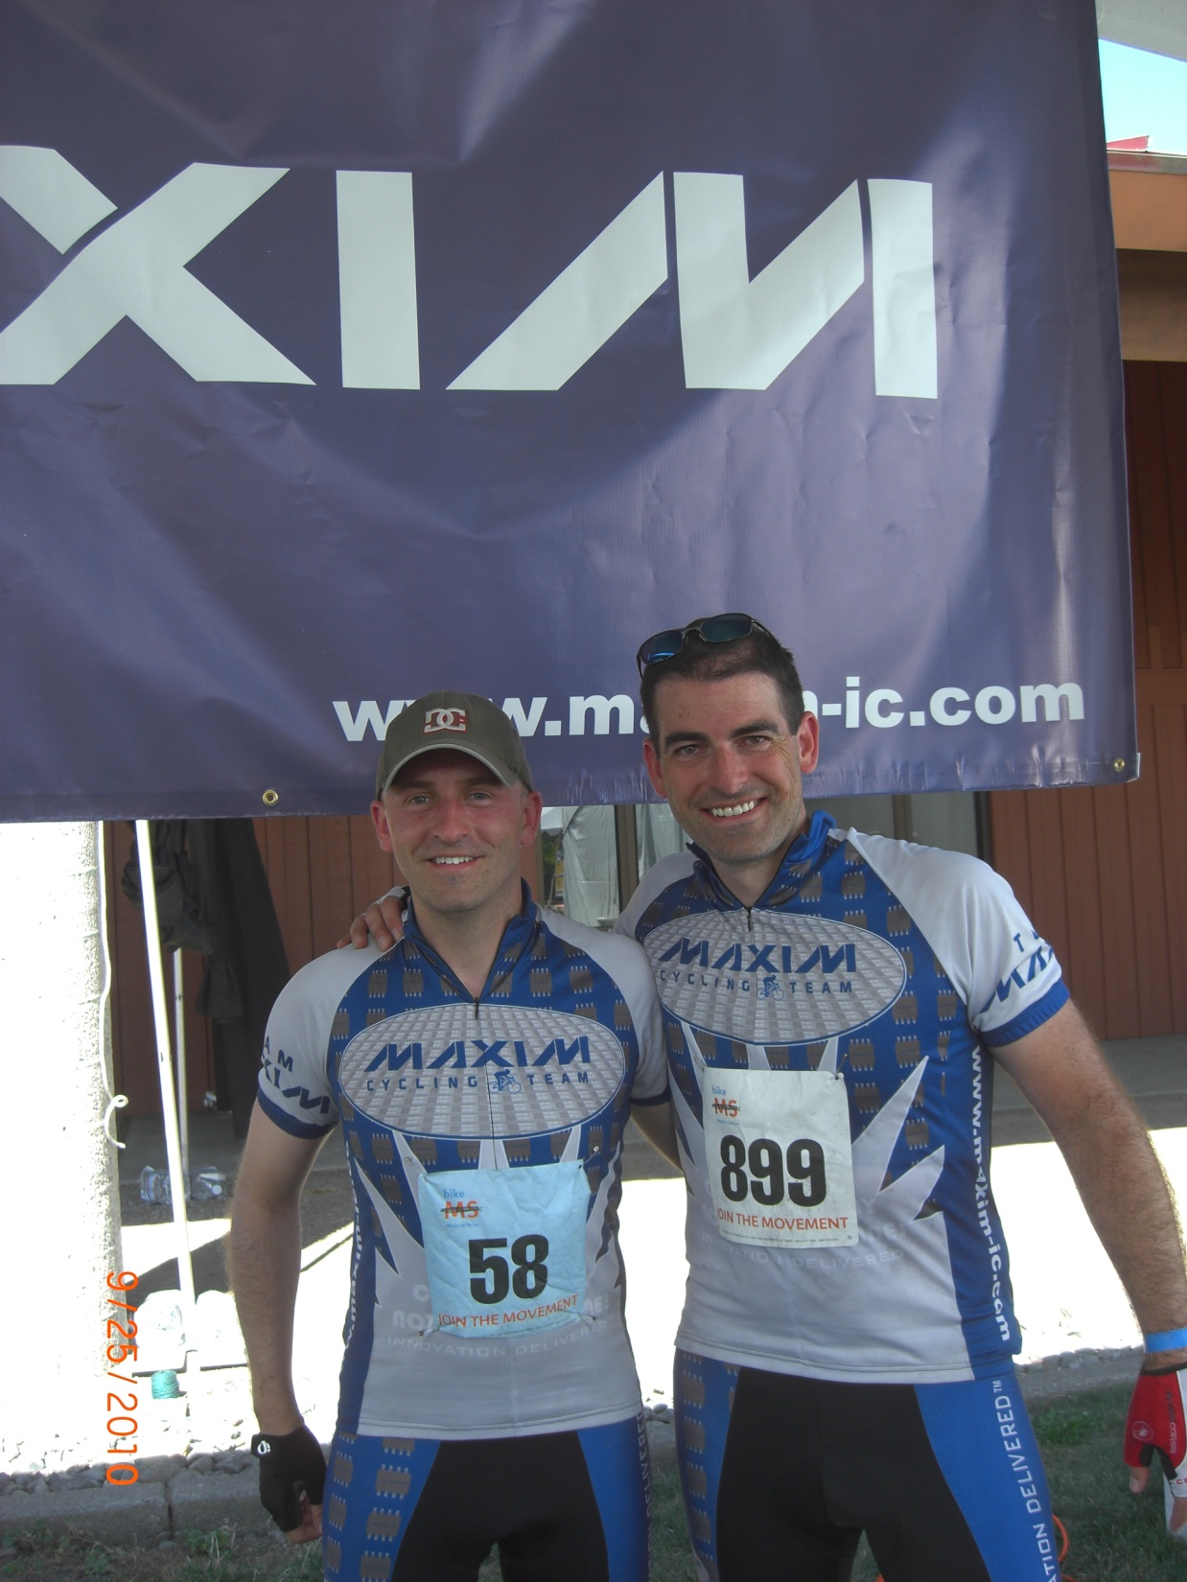
Eventually, I moved into a general management and an executive role.
Strategic planning
Leading large, multidiscipline organizations (current team is over 150 people) with offices in US, China, India, and Europe.
Business development – acquisitions, partnerships, contracts, etc.
Full P&L responsibility
Many, many more meetings. Lots of these meetings are highly technical and require my engineering background. The large majority of my employees are engineers.
Team Maxim rode to raise money for MS.
Here are some fun facts from last year's Team Maxim ride: Miles Rode = 151.14 miles Average Speed = 16.4 mph Max Speed = 42.3 mph Total Climb = 10,459 ft Total Riding Time = 9 hours 13 minutes Calories Burned = 11,271
Dan

Slide 41
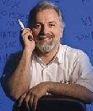
William S. Yerazunis
MERL Research / Technical Staff Senior Principal Member Research Staff & Hardware Team Leader Ph.D., Rensselaer Polytechnic Institute, 1987 William Yerazunis is a Senior Research Scientist at Mitsubishi Electric Research Laboratories in Cambridge, Massachusetts, USA. He received the B.S., M.Eng, and Ph.D degrees in Systems Engineering from Rensselaer Polytechnic Institute, in 1978, 1979, and 1987, respectively. Since then, he has worked in a number of fields including optics, machine vision, and signal processing (for General Electric's jet engine manufacturing); computer graphics (at Rensselaer's Center for Interactive Computer Graphics); artificial intelligence and parallel symbolic computation (for DEC's OPS5, XCON and RuleWorks); radioastronomy and SETI ( at Harvard University), transplant immunology (for the American Red Cross), virtual and augmented reality, realtime physical and chemical sensing, and ubiquitous computing (for Mitsubishi Electric), and realtime statistical categorization of texts (the CRM114 Discriminator anti-spam system). He is also a Visiting Scientist at Dublin City University in Dublin, Ireland. He has appeared on numerous educational television shows, holds 35 U.S. patents, sports an Erdos number of three, a Kevin Bacon number of three, holds FCC ham radio Extra class and Commercial Broadcast/radar engineer licenses, and was voted one of the 50 most powerful people in networking by NetworkWorld magazine in 2006.

Slide 42
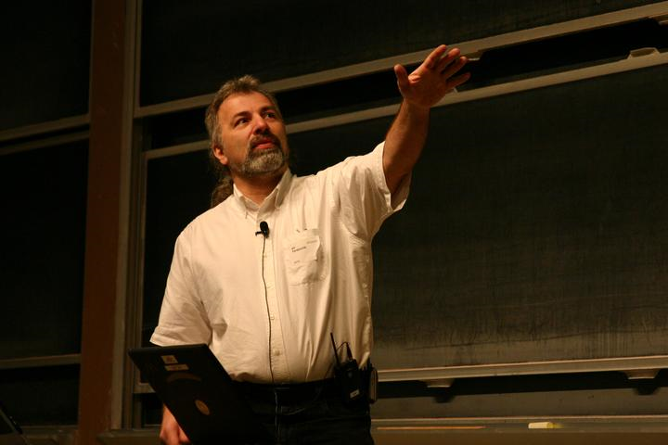
00:00 Asleep. 02:30 Awakened by crying 9-month-old identical twin babies. Deal. 03:00 Asleep again. 05:50 Up to shower, shave, dress. 06:27 Off to the train 06:37 Sit down on the train, surf on wireless a bit, and notice a bug in some C machine learning programs. 07:55 Get a Taquito at 7-11
07:59 At my desk. Check into the email. 08:30 Done with email. 08:31 Check the spambucket. 08:32 Done with spambucket.

Slide 43
08:33 Grab an orange juice, start debugging the C machine learning code.
09:30 Find out we really are demoing an "oooh aaaah" project to visitors from headquarters. 09:40 Check the demo setup one last time. No problems. 09:50 Pick up some new parts for an infrared light project from Lou in Receiving. Can't resist playing with them for 20 minutes or so. 10:10 Back to the C machine learning code debug session. 11:00 Into Japanese language class. 11:30 Pop out of Japanese class to do the "oooh aaaah" demo. 11:45 Achieve goal of "oooh aaaah" (literally! Managers make that noise if you apply enough shock and awe) 11:55 Back into Japanese class. 12:00 Lunch! Decide to ditch a meeting on a project I'm not useful for.

Slide 44
12:30 Scour YouTube for videos on the Chilean mine rescue in progress that actually show the hardware! 12:50 Thwarted by Faux News, who saturates YouTube with crud. 13:00 Do a consult on a mechanical servo design. Minor changes needed. 13:40 Check a box of stuff to be scrapped - mostly old fuel cell parts. I fish out the hard-to-get platinium catalysts, and toss the rest. 13:50 Back to the C code debug session. 14:30 Small meeting on whether to patent some stuff or just publish it as soon as possible and move forward. 14:50 Do a consult on network security for the company. Bottom line is that we need to redo the mailservers and need to find someone competent and trustworthy because we're all overbooked. 15:00 Back to the C debug session. Seems to be a problem in growing the db, as it goes away if I init the db really large to start.

Slide 45
16:00 Start a first draft of the project proposal for next fiscal year
16:26 Phone alarm goes off to tell me to get my stuff together and get on the train for the evening commute. 17:00 Onto the train. Make another attempt to see what's going on with the Chile rescue. CNN.com says 26 up already (yeah!) 17:05 Find the company making the Plan B drills. Center Rock, in Berlin, PA. Consider sending them an "Attaboy" letter, because they're the real heroes in this. 17:06 Back to this ^*&*(% C code debug on the laptop. 17:57 Back home! Make some cheesy rice and cold-and-sour soup for the 3-year old (he likes it cold. Go figure), and some hot and sour soup for me. Wife wants her leftover Chinese too. The twins are already fed and falling asleep.
18:30 Gear up and head to Kung Fu workout. 20:05 Back home from Kung Fu. 20:10 Soak in hot tub till legs stop hurting.

Slide 46
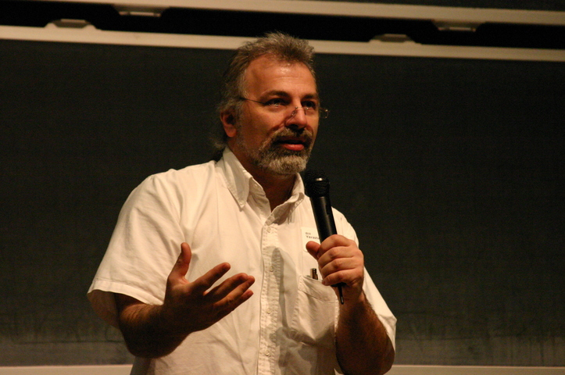
20:30 Check email for a conference schedule I'm helping on. No joy. 20:40 Oh- rereading con-com's reply, that teleconference is tomorrow night, not tonight. Silly me. 20:41 Drown my sorrows with chocolate milk and Chocolate Fudge Oreos. 20:42 Decide between "Supernatural" and "Team Fortress". Team Fortress wins. 21:20 Manage a nice backstab as a Spy disguised as a Medic in TF. 22:07 Decide it's time for bed. 22:10 In bed. 22:11 Asleep. 23:59 Dreaming about what a control system GUI should look like.

Slide 47
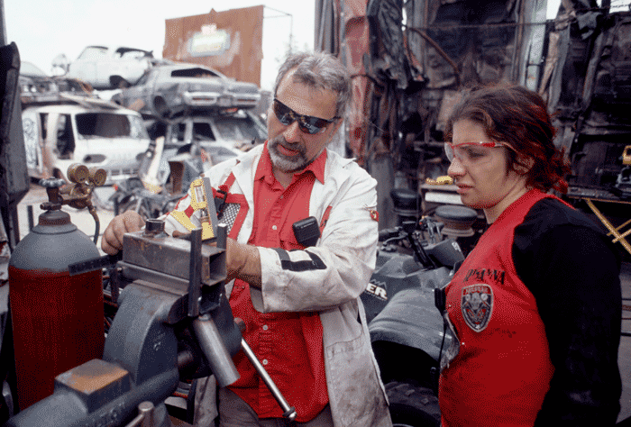
In the office he’s William Yerazunis, PhD. On the Junkyard Mega-Wars set, he’s Crash, team captain and self-proclaimed nerd. Yerazunis, who works as a research scientist at Mitsubishi Electric Research Laboratories, is a regular on the The Learning Channel (TLC)’s Junkyard Mega-Wars, a program in which two teams compete to build a vehicle from discarded materials.

Slide 48
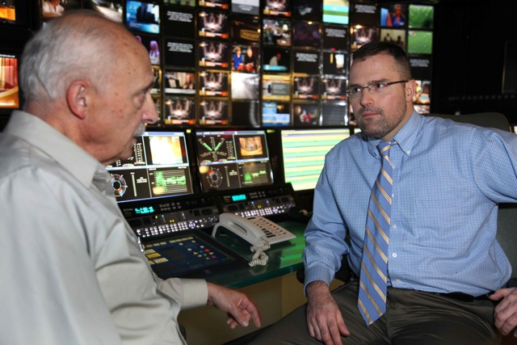
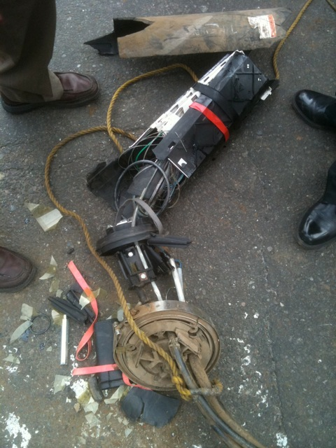
TW Broadcast Operations Control Room
James Manchester - President Network Operations & Engineering NYC/NJ at Time-Warner Cable EE 1995
Inspection of a fiber closure that was run over by a bus in Manhattan. The bus ran through our safety cones while our plant maintenance teams were repairing a massive fiber issue that resulted when Verizon conduit caught fire underground. The bus never stopped. There were multiple 400+ count fibers in the closure.

Slide 49
A Day at Time Warner Eng.
8 am - 9 am: Breakfast with Headend and Hub techs. Breakfast and open forum for the headend and hub techs to talk to me about issues, concerns, etc..
9 am - 10 am: Bi weekly meeting with our Commercial Services Sales Organization. Meeting to review various projects to support 20% commercial services revenue growth. This year we have added fiber to our infrastructure to make serviceable 1,900 buildings opening up 17,000 commercial establishments.
10 am - 12 noon: Hub C Visit. Hub C serves 110k customers on the upper east size and is currently out of space and power and as a result is also suffering from HVAC issues. A review of the facility shows the dire condition it is in. Numerous devices are not on dirty power (not on protected power). A deli next door has been leased to place spot coolers to try to alleviate cooling issues. A dispute with the landlord is preventing us from moving forward with desperately needed upgrades and we will have no choice but to move the Hub to a new location. We tour some suggested sites nearby recommended by corporate real estate. A move of the Hub will cost about $10M and take about 18 months from start to finish.
12 noon - 1 pm: Lunch at City Crab on Park Ave with sales vice president from Arris to review the status of their dense QAM deployment in our Queens footprint.

Slide 50
A Day at Time Warner Eng.
1:00 - 3:00: Weekly Performance Metrics review with regional vice presidents. In this meeting we review weekly outages and their resolutions, trouble calls per hub, major events, VOIP readiness, High Speed Data growth, utilization and trending, Set Top Box performance, and VOD and Switched Digital utilization reports. Action items are assigned to mitigate any problems or negative trends that are identified.
3:00 - 4:00: 2011 Budget Review with the Capital Management team. Continue to refine capital budget for 2011 with significant focus on trimming maintenance costs associated with capital.
4:00 - 5:00: BST Digitization Business Case. Review status of the business case for digitizing analog basic. The plan is centers around recovering 30 QAMs worth of bandwidth but we would have to put a digital box on every basic only customer connecting directly to our system viewing analog channels.
5:00 - 6:00: Personal Time. Catch up on email, return phone calls, review personnel situations (promotions, recognition, and disciplinary issues), and review and approve/deny new purchase requests.
Throughout the day I am also monitoring all the NOC notifications on issues in the field.
Then I usually head home and eat dinner and try to relax a little. I try to leave by 6 pm because the job is 24x7. You could keep working and working, etc.. Inevitably something major happens (fiber cut, power outage, etc) in the evening resulting in me joining a bridge or preparing a status report for the CEO/CTO/COO of the company.

Slide 51
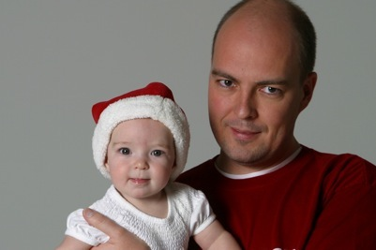
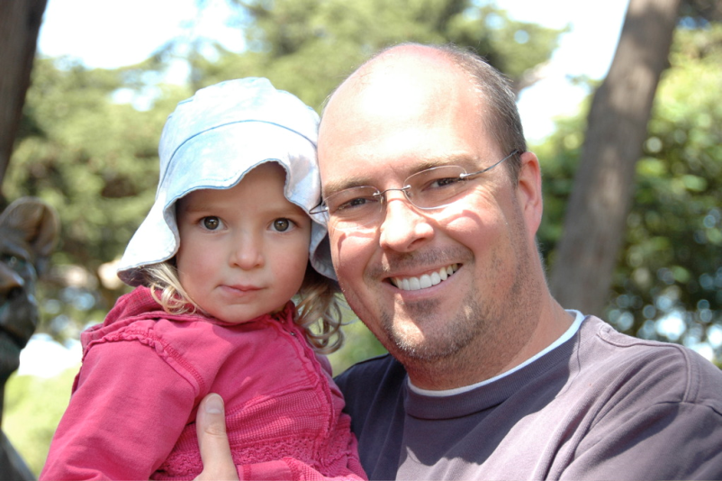
Lorenz Redlefsen – Arista Networks
Background: I finished my BS ECSE at RPI (class of '95), then went on to grad school at Stanford, thinking I'd do a PhD, but "dropping out" with an MS EE in '97. While I'm an "EE" in title, I'm a "software guy" day-to-day. I started my work career at Cisco, where I wrote software for their Catalyst 4000 series of Ethernet LAN switches for 8 years, then went to Arista Networks, where I have been writing software for Ethernet switches since 2005.
Most people think of infrastructure like networking boxes as boring stuff, until they learn more about what goes on inside them. There are very interesting problems to be solved, and the products are used all over the place.
http://www.redlefsen.com/

Slide 52
Day-to-day stuff:
Most people refer to the software running on embedded devices as "firmware", but on modern devices, we're talking about a real operating system. Arista's OS is basically a full-blown Linux distribution (Fedora 12), with our own software running on top. This software includes drivers for special-purpose chips ("ASICs") and components such as lasers and DSPs that operate at 10Gbps (meaning these components have 0.1ns (100ps) per bit!), as well as networking protocols and system management code. It runs on a dual-core x86 CPU with 4GB of RAM -- a real computer! Our code is written in C, C++, and Python.
Our products are used as the "glue" that connects together thousands of computers for massive websites (think Google, Amazon, Facebook, Twitter, Ebay, etc.), and also to build cost-effective supercomputers ("clusters" of thousands of servers).

Slide 53
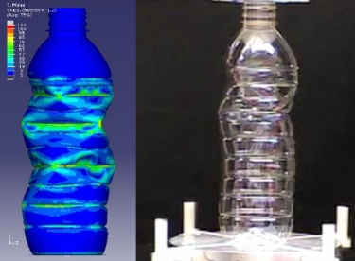
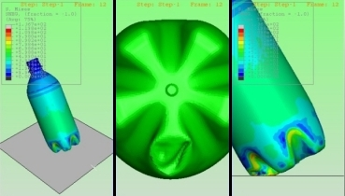
The key is to drive down the cost of large-scale computing by taking low-cost commodity x86 servers and connecting them using low-cost networking gear. Just two examples of how this is helpful:
1. Car companies can do "virtual crash tests" -- nowadays, they pretty much know the outcome of a crash test before they ever build the first prototype and smack it into a wall.
2. Packaging companies perform finite element analysis on things like plastic water bottles, minimizing the amount of plastic required to make a stable bottle. (Have you noticed how plastic water bottles have gotten thinner over the last couple of years?) Multiplied by billions of bottles per year, this results in significant reduction of the amount of plastic used for these bottles. http://www.plastictechnologies.com/services/td/fea/

Slide 54
Nikon Precision - North American lithography subsidiary of Nikon Corporation
David Huchital – Former Chief Executive Officer and President
The day I chose is one in which a had a lot of fun and was also able to make a significant contribution. It would have been in the 1970's and I was working in the Research Department of Perkin Elmer Corp. My fellow researcher, George Steinberg, and I had been tasked with trying to improve the discipline of atomic absorption (AAS) spectroscopy, a mainstay of PE's business. AAS is an elemental analysis technique requiring generation of resonance radiation from the element in question and directing it through a hot burner into a monochromator tuned to the resonance wavelength. A sample is aspirated into the flame and presence of the element in question is indicated by an absorption of transmitted wavelength.

Slide 55
To that point the radiation had been generated in a glow discharge tube which used the subject element as part of the cathode structure, thus atoms were sputtered out of the cathode and electron collisions excited them to produce radiation. These so-called "hollow cathode lamps" were the weak point of the technique as the radiation was of low intensity and unstable. Attempts had been made at microwave excitation but the results were little improved. We had heard that rf excitation might be effective and proceeded to build a simple resonance circuit and midnight-procure a small rf generator. Our glassblower sealed small flecks of the required metal into evacuated glass ampules that had been backfilled with a few mm pressure of a rare gas.
The results exceeded our expectations, especially for the high-vapor pressure materials such as arsenic, mercury, thallium, cadmium, etc. Detection limits for these (dangerous) trace metals were reduced by several orders of magnitude with significant implications for the environment especially in water supplies.

Slide 56
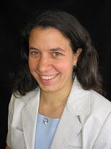
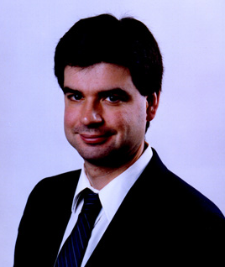
 |  | KRISTA J. GILE Assistant Professor Department of Mathematics and Statistics University of Massachusetts
Ph.D.: University of Washington, Statistics, 2008 M.S..: Virginia Polytechnic Institute and State University, Science and Technology Studies, 2000 B.S.: Rensselaer Polytechnic Institute, Electrical Engineering, 1998
Research: developing statistical methodology for social and behavioral science research, particularly related to making inference from partially-observed social network structures.
Russell Tessier
Associate Professor Electrical and Computer Engineering University of Massachusetts EDUCATION: B.S.C.S.E., Rensselaer Polytechnic Institute, 1989 M.S., MIT, 1992; Ph.D., MIT, 1999
RESEARCH INTERESTS: Reconfigurable Computing. Field-Programmable Gate Array Architecture. CAD Algorithms for FPGAs. FPGA-based Logic Emulation.

Slide 57
One Last Demo
Go to my webpage to see many useful links with career information.
Also go to MobileStudioProject.com
to learn about this protypical EE, CSE project.

Slide 58
The End
Best of luck
Questions?

